Slide 1
Software Development with Java
Dzmitry Marchankau 2024

Slide 2
Java developer’s tools
Build tools
Maven, gradle, ant
Web servers
Tomcat, Jetty, JBoss
Version Control Systems
Svn, Perforce, git
Frameworks Spring, Java Enterprise
Other tools

Slide 3
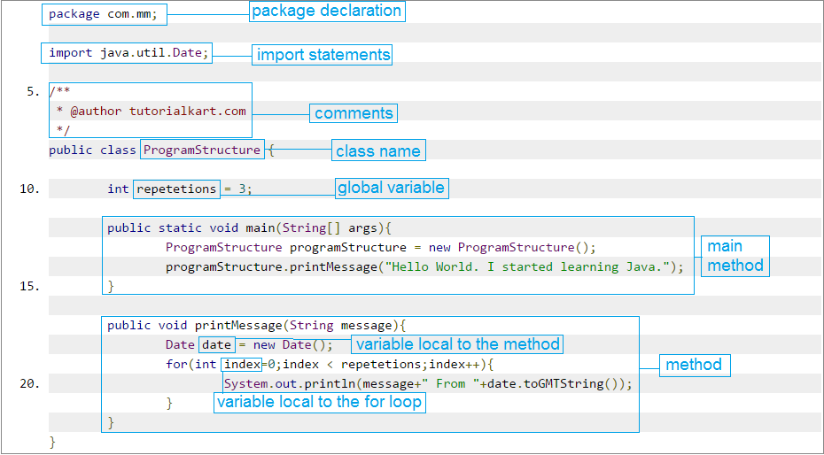
Java program structure

Slide 4
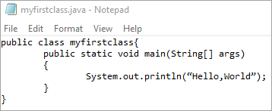
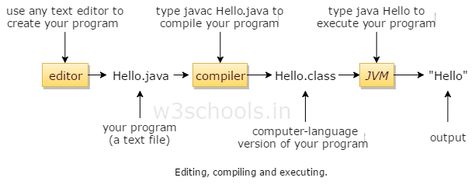
Compiling and running Java code

Slide 5
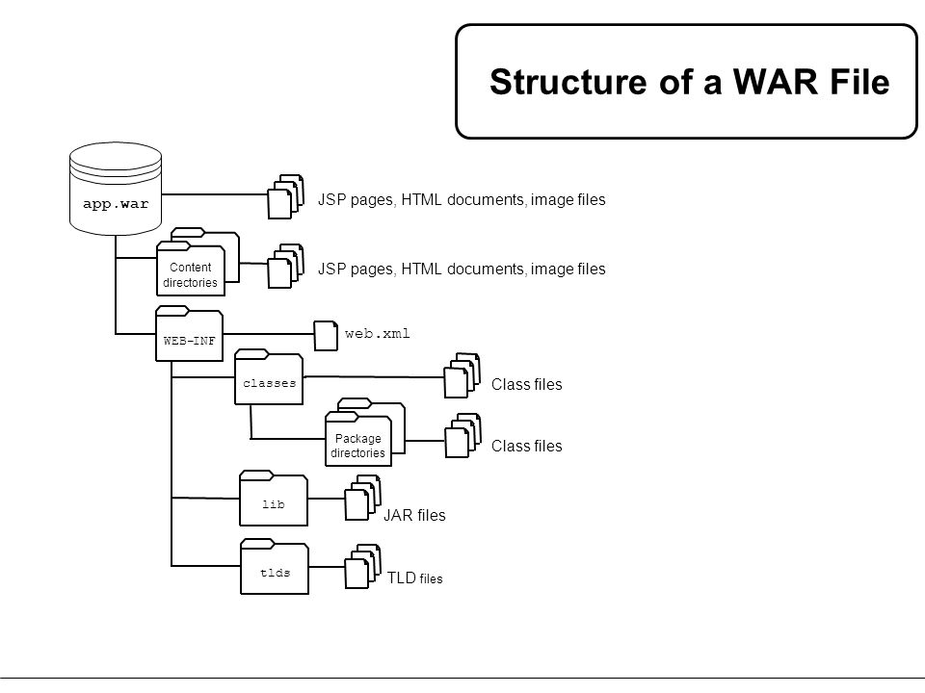
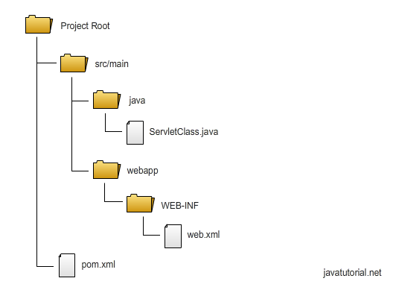
Web app structure

Slide 6
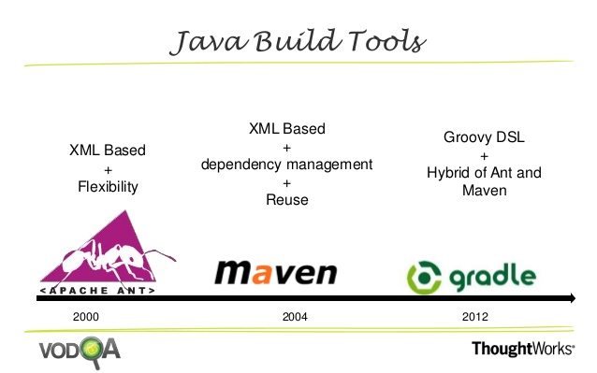
Build tools for Java

Slide 7
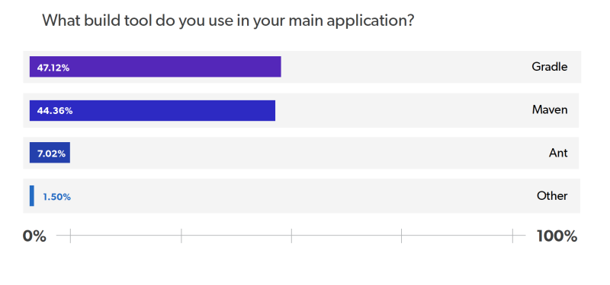
Build tools for Java

Slide 8
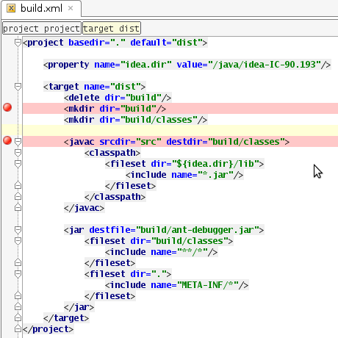

Ant for Java

Slide 9
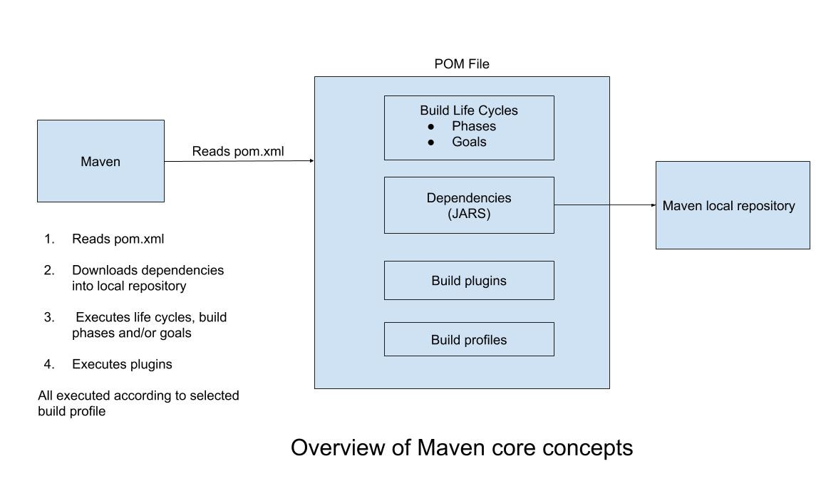
Maven for Java

Slide 10
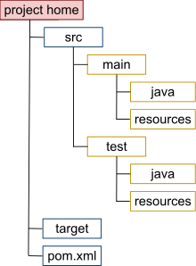
Maven for Java

Slide 11
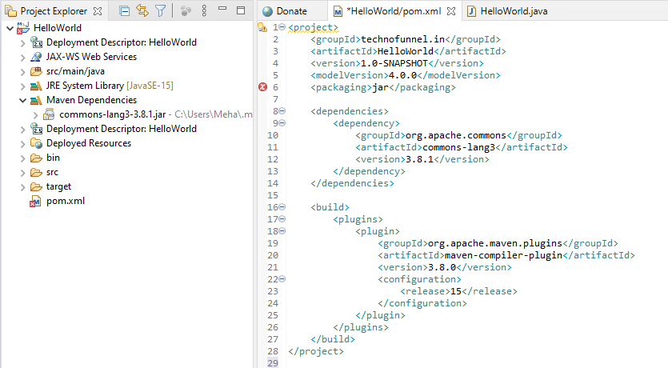
Maven for Java

Slide 12
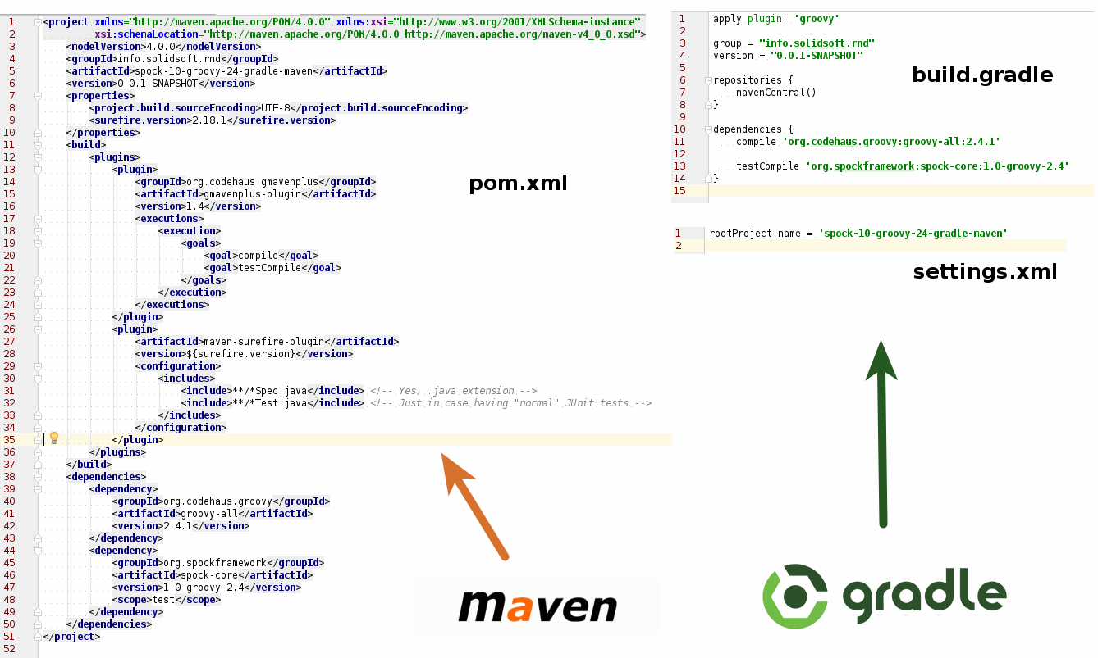
Gradle

Slide 13
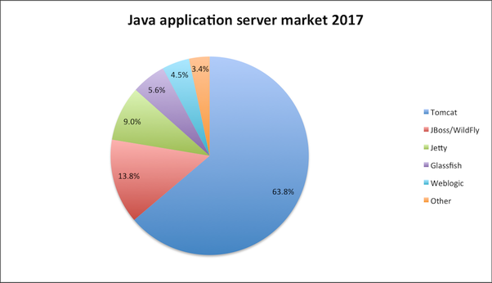
Web servers for java applications

Slide 14
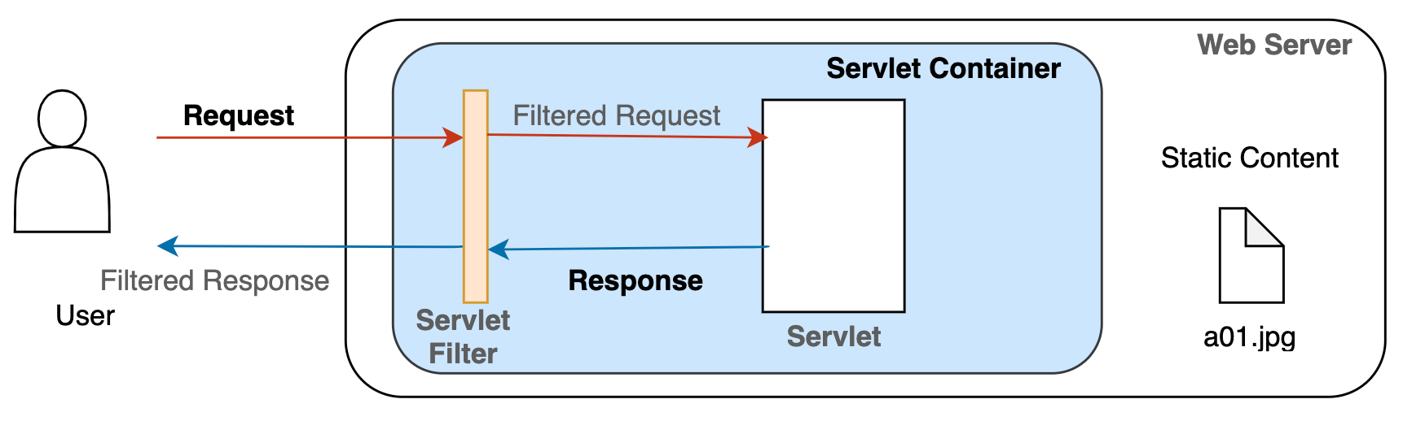
Servlet container

Slide 15
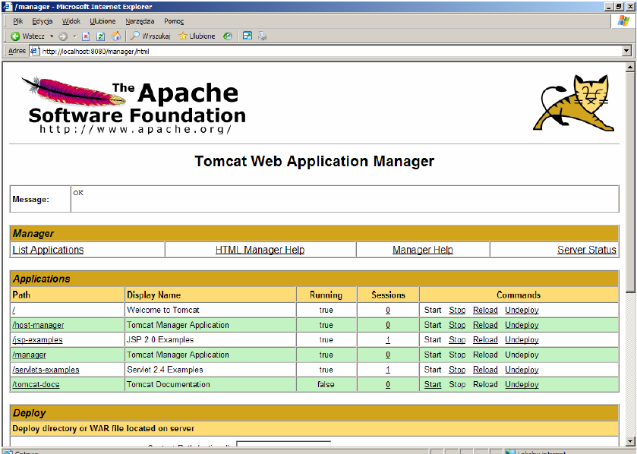
Apache Tomcat

Slide 16
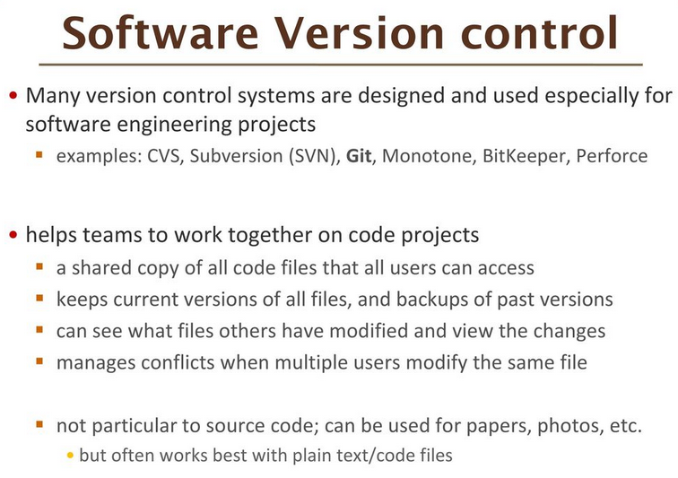

Slide 17
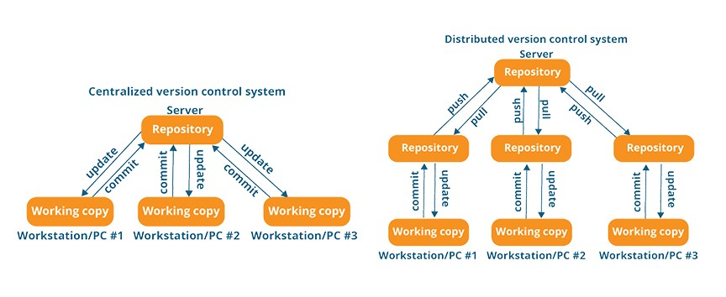
Version Control System

Slide 18
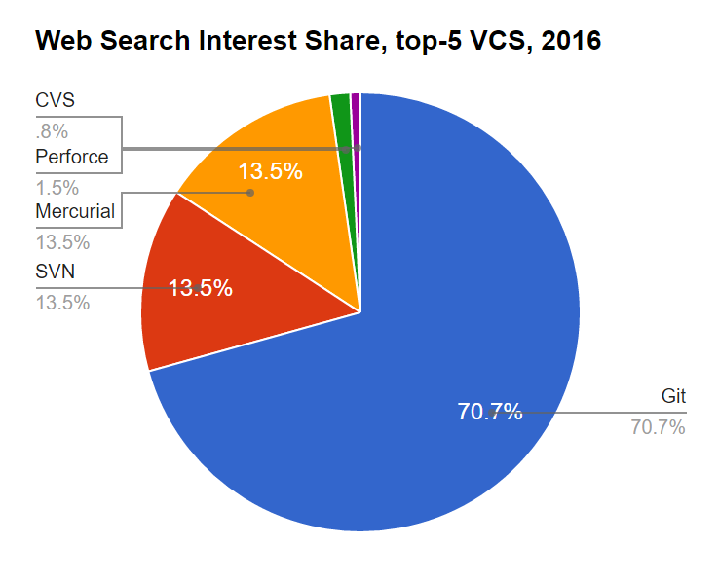
Version Control Systems

Slide 19
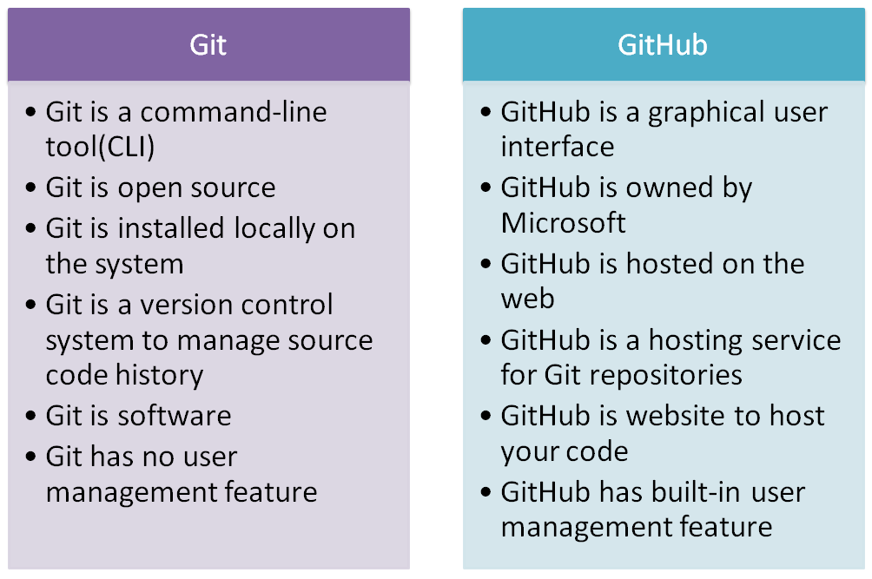
Git vs GitHub

Slide 20
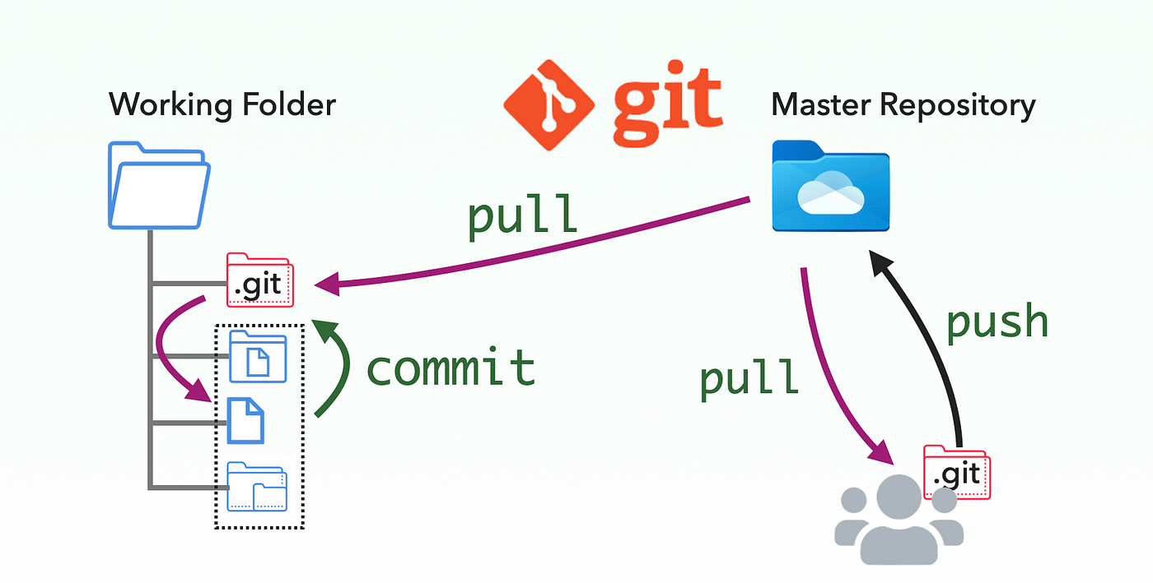
Git workflow

Slide 21
Java frameworks
Java Frameworks are the application skeletons or complete structures that provide the programmer with the basic tools of creating a web-based application or any kind of software.

Slide 22
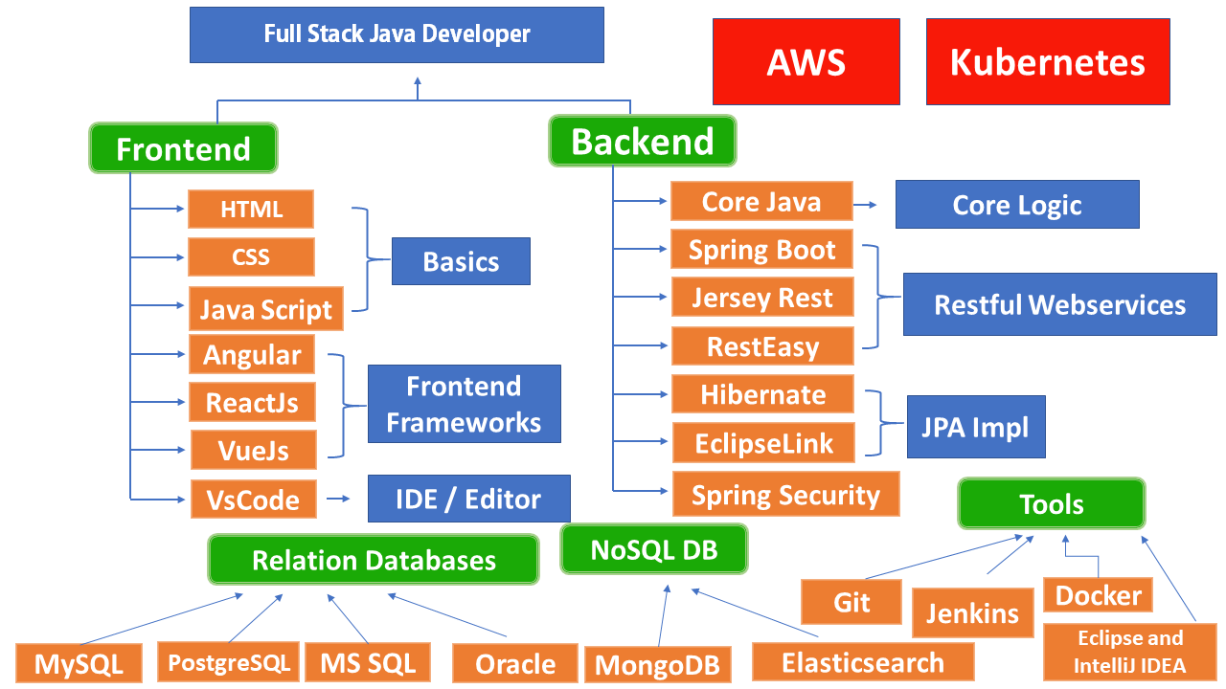
Technology stack

Slide 23
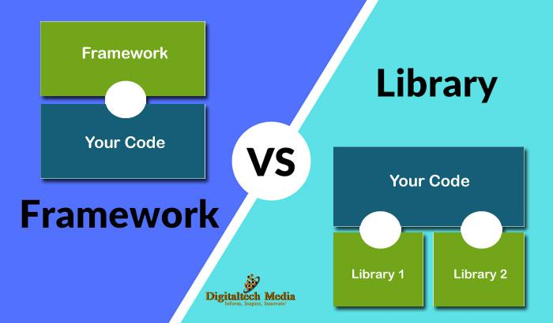
Libraries and frameworks

Slide 24
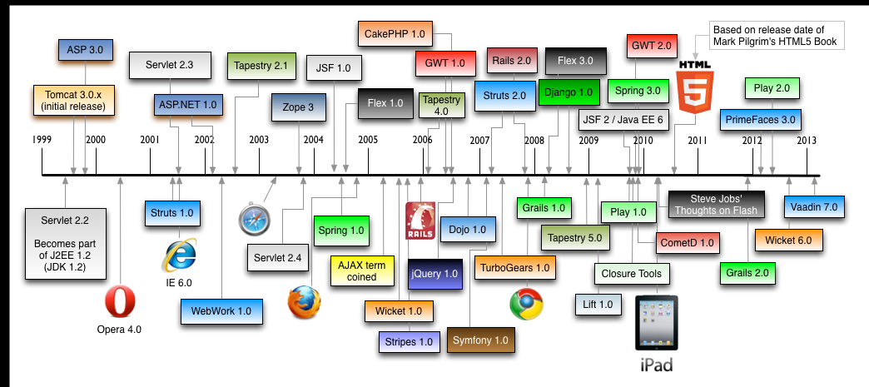
History of web dev frameworks

Slide 25
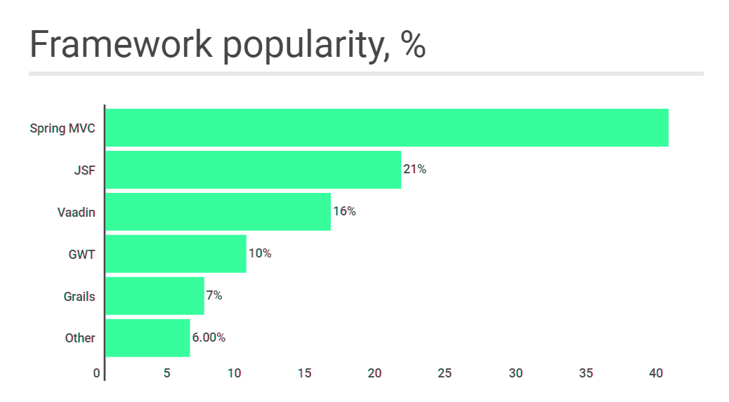
Java Frameworks

Slide 26
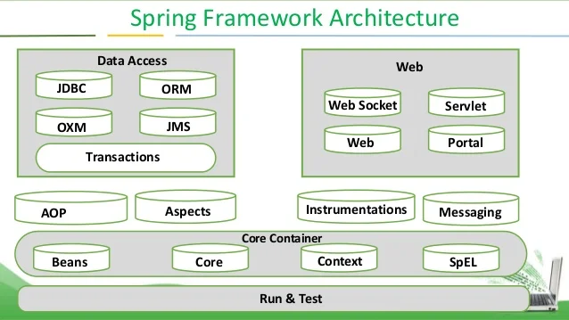
Spring Architecture
Notes:
https://proselyte.net/tutorials/spring-tutorial-full-version/introduction/

Slide 27
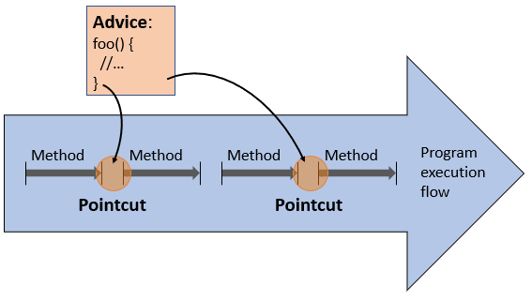
Spring basics: AOP

Slide 28
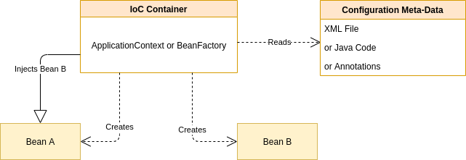
Spring Core

Slide 29
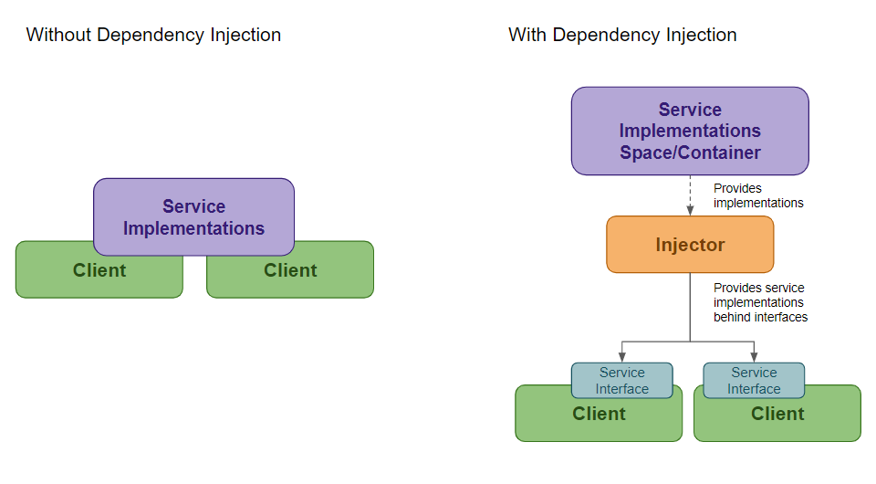
Spring basics: dependency injection

Slide 30
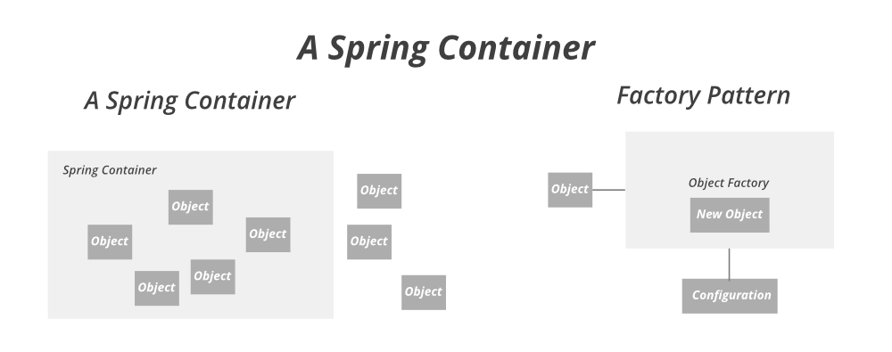
Spring container

Slide 31
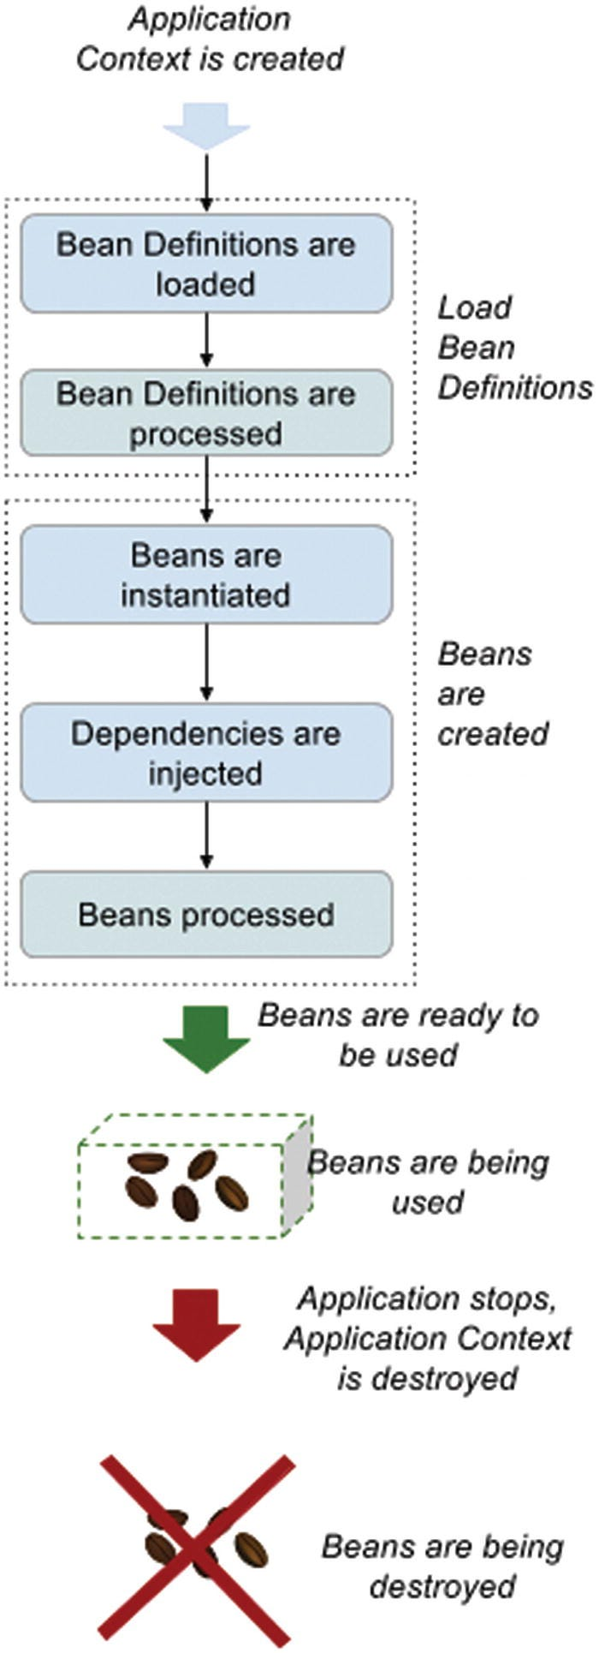
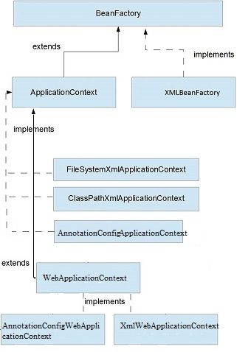
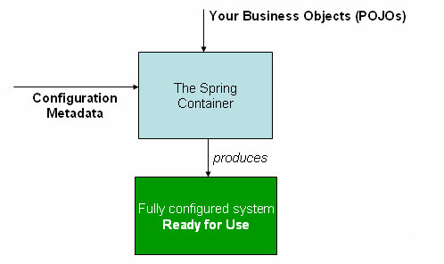
Spring containers

Slide 32
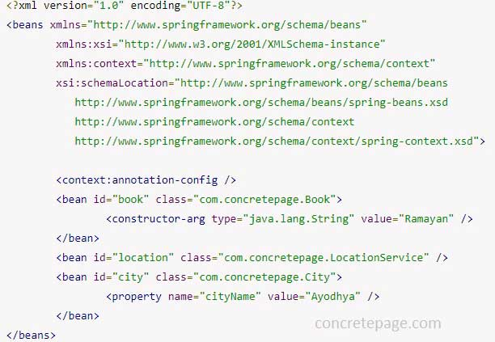
Spring configuration
The ApplicationContext is created and initialized with configuration metadata that describes all the beans. Configuration metadata can be specified via XML, Java code or annotations.

Slide 33
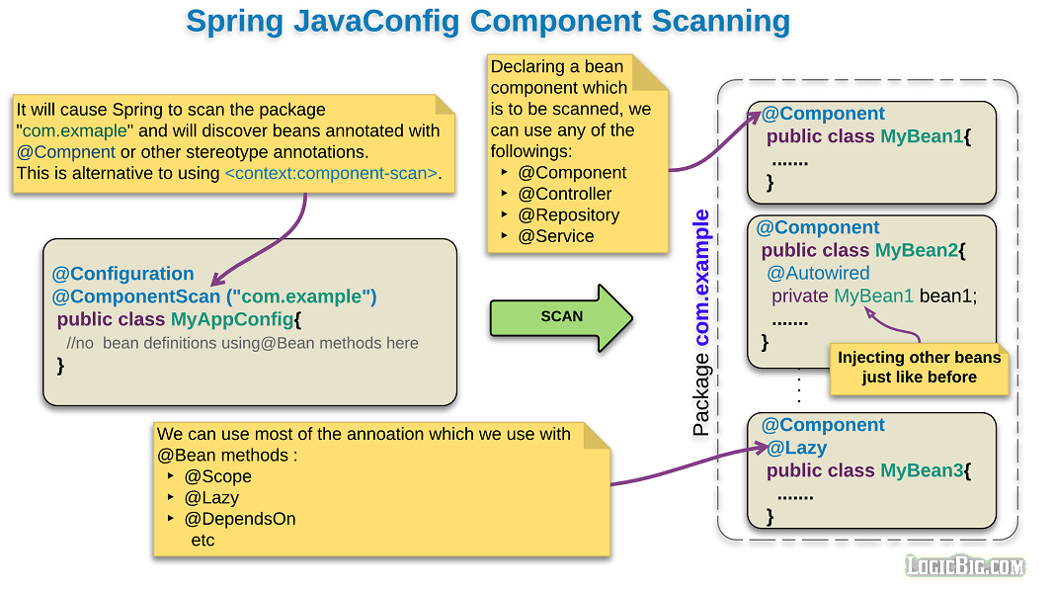
Spring configuration

Slide 34
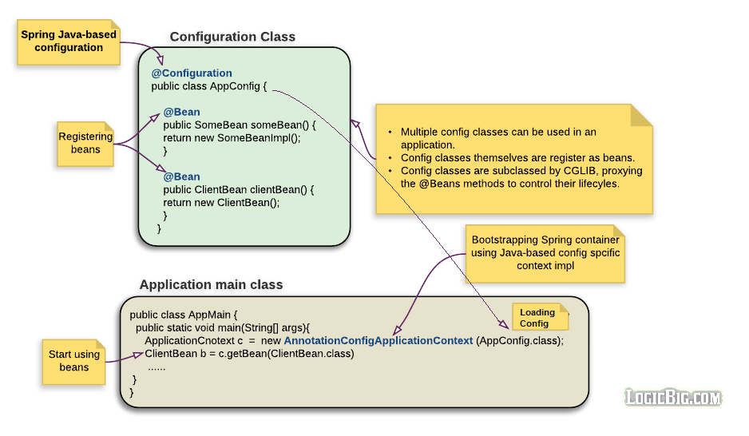
Spring configuration

Slide 35
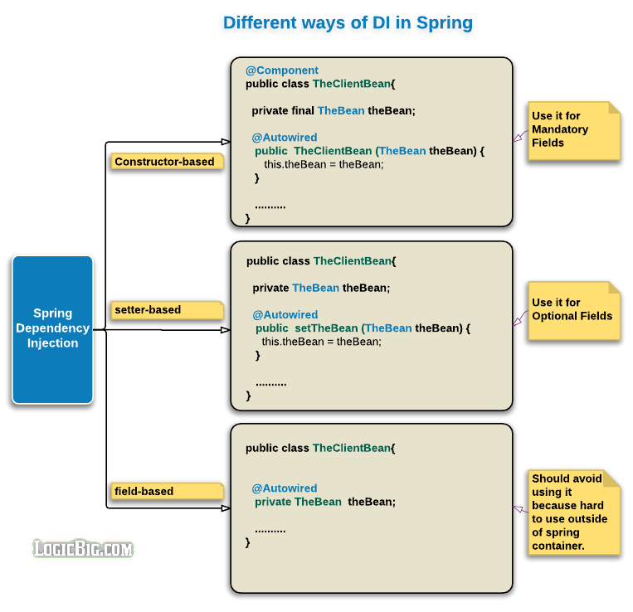
Spring configuration

Slide 36
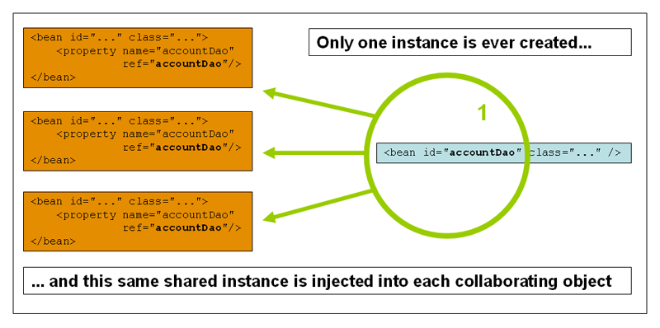
Spring bean scopes: singleton

Slide 37
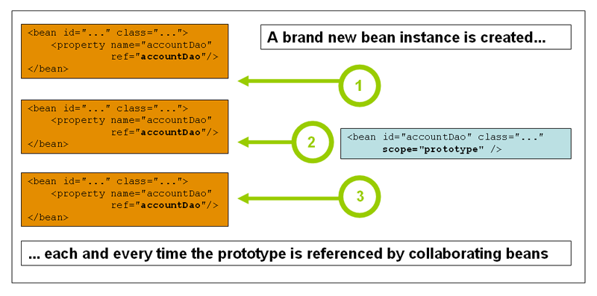
Spring bean scopes: prototype

Slide 38
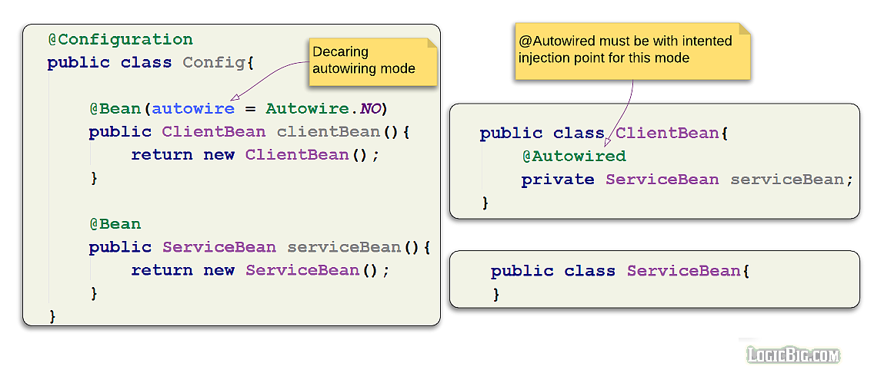
Spring autowiring

Slide 39
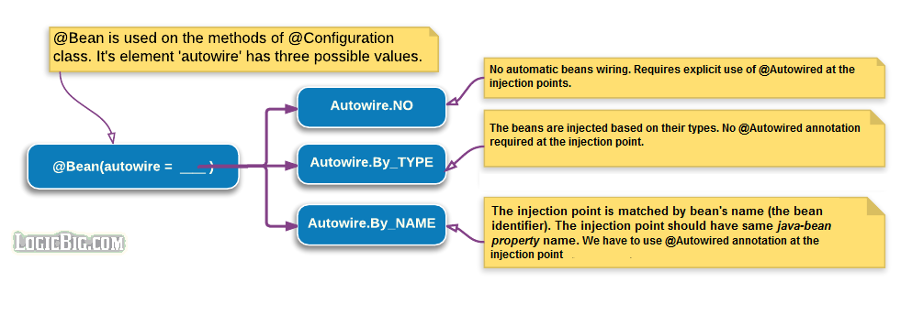
Spring autowiring

Slide 40
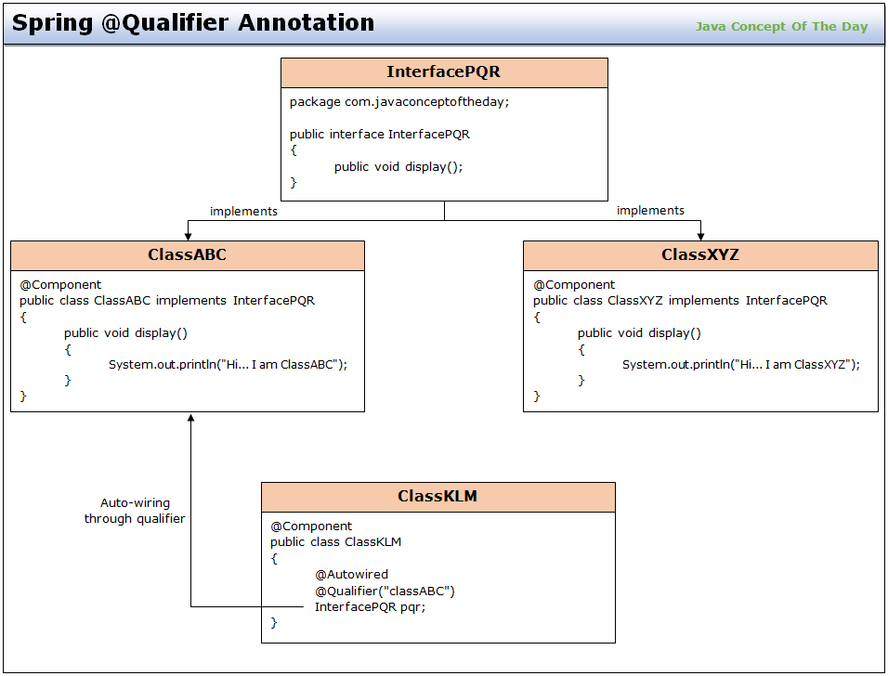
Spring autowiring

Slide 41
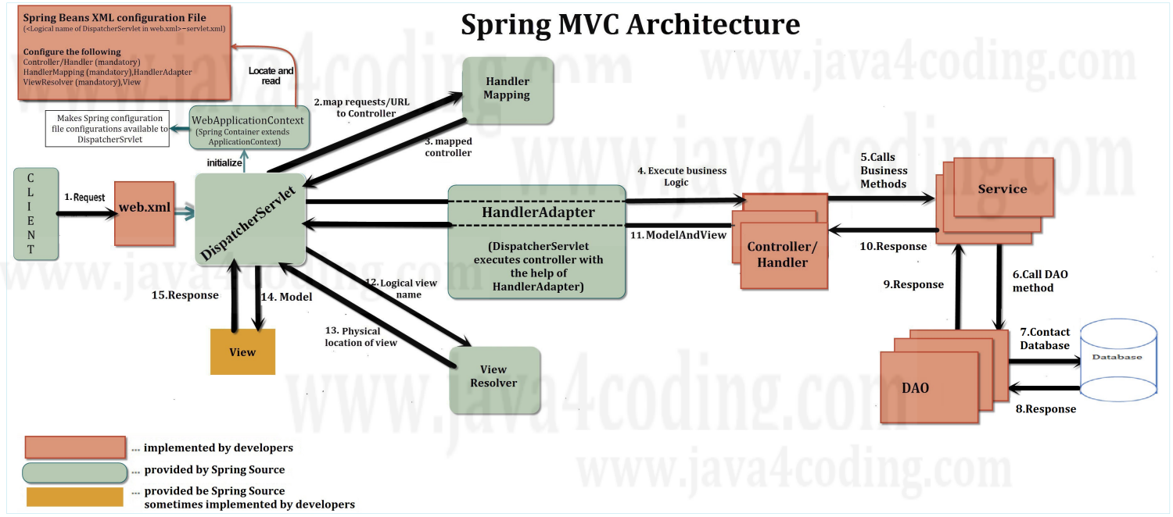
Spring MVC

Slide 42
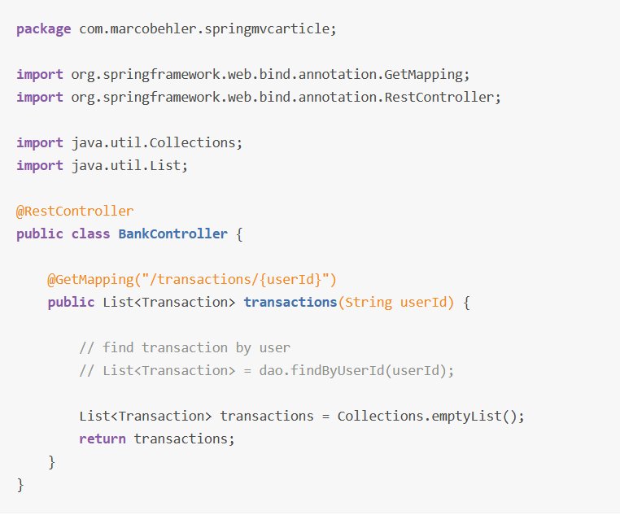
REST service using Spring MVC
Notes:
https://habr.com/en/articles/500572/

Slide 43
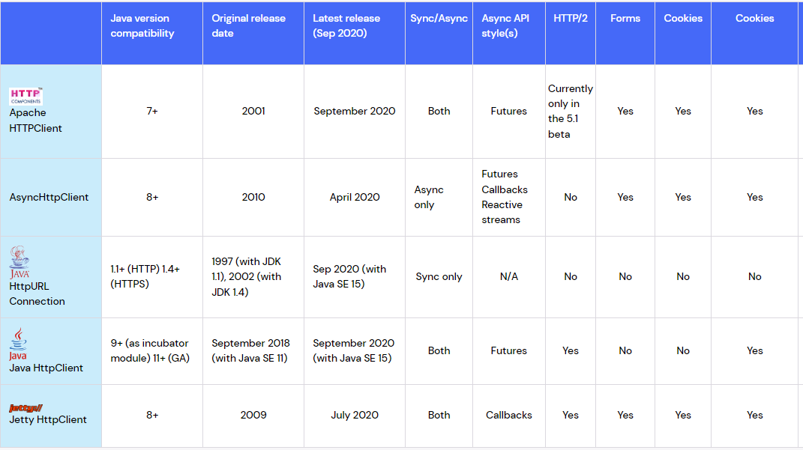
REST consumption: Java HttpClient

Slide 44
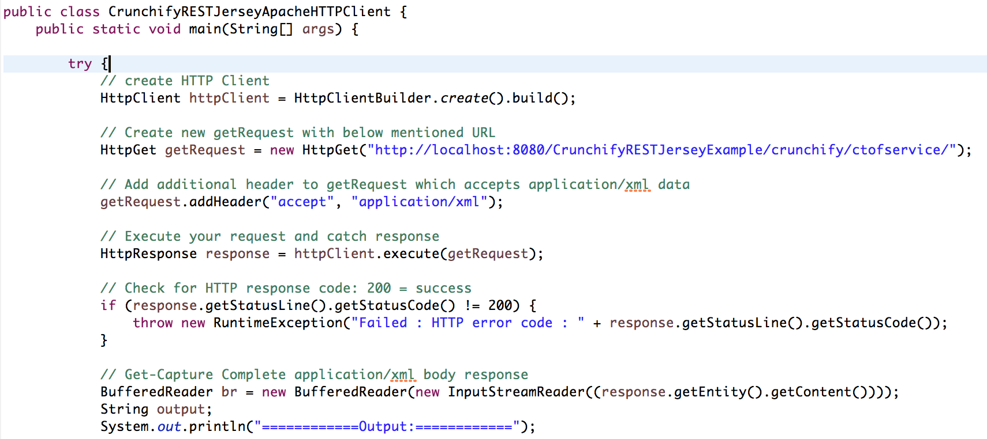
Java HttpClient code example

Slide 45
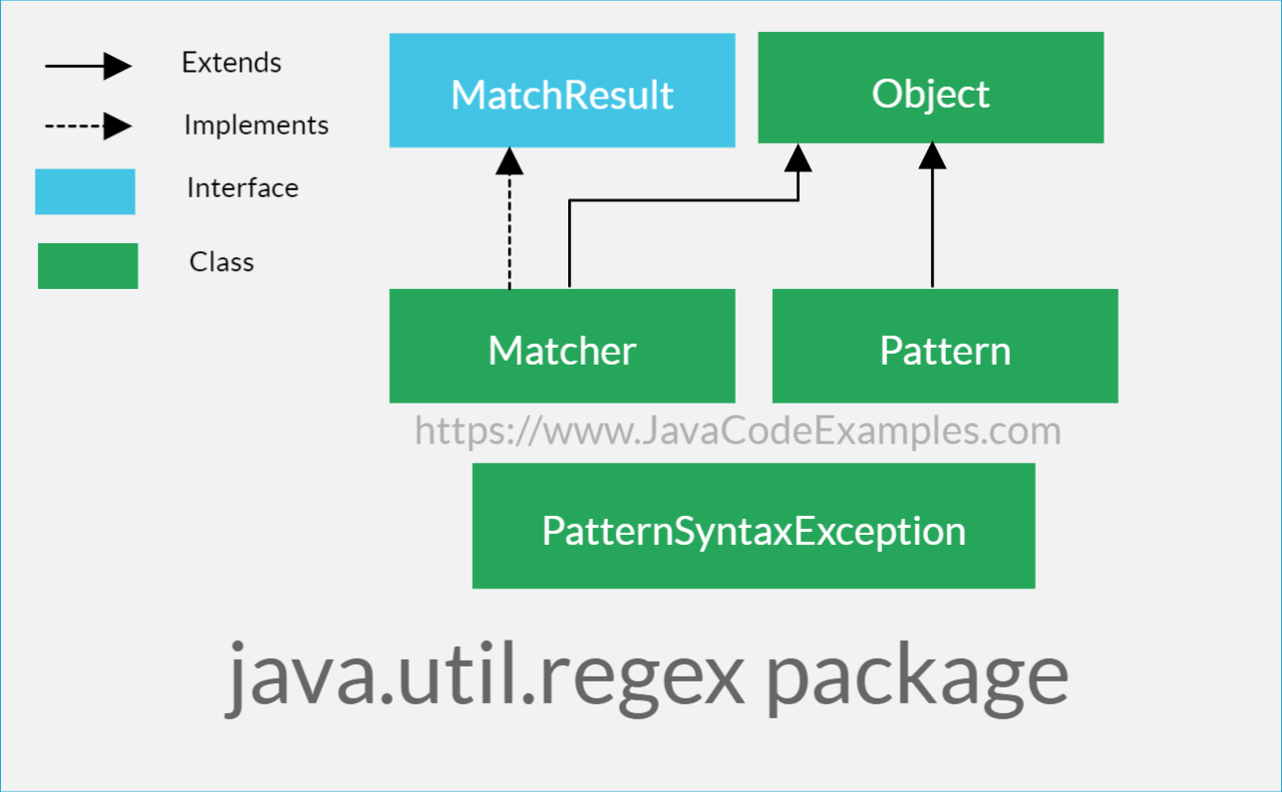
Java RegEx package

Slide 46
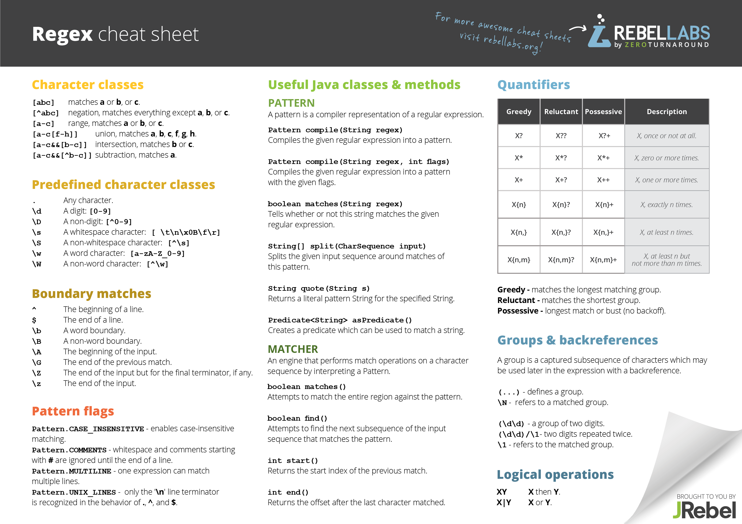
Java RegEx cheat sheet

Slide 47
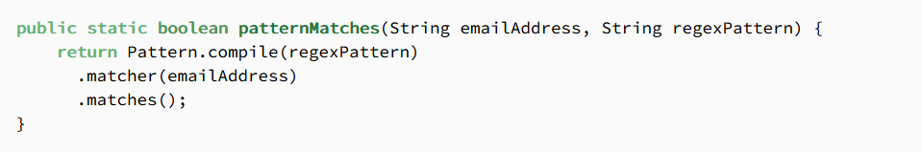
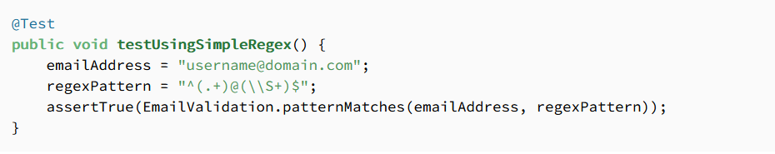
Java RegEx example
Notes:
https://www.baeldung.com/java-email-validation-regex

Slide 48
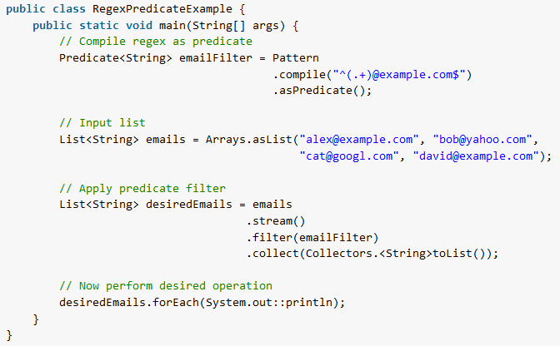
Java RegEx example

Slide 49
API testing tools
Postman
Manual and atomated API testing Supports REST and SOAP API’s
SoapUI
Coding capabilities to create complex-scenarios Supports REST and SOAP API’s Jmeter Open-source Load Testing tool Uses CSV files to allow for data driven API testing SwaggerUI Automated API documentation library
Advanced Rest Client Easy tool for API testing Supports GET/POST HTTP methods

Slide 50

soapUI

Slide 51

Postman

Slide 52

Advanced REST Client

Slide 53

JMeter

Slide 54

Swagger UI

Slide 55

Swagger with Java annotations

Slide 56

Browser network console!

Slide 57
Questions ?

